Slide 1

PagePal
Your Mood-Based AI Reading Companion
Ishan Singhal
August 2, 2025

Slide 2

What is PagePal?
Why was it created?
An AI-powered chatbot designed to recommend books based on your current mood and preferred genre.
To simplify book discovery and enhance the reading experience by offering personalized suggestions.
Built as a student project using IBM Watson Assistant to explore AI conversational design.

Slide 3





Core Features
Mood-Aware Recommendations
Genre Filtering
"Surprise Me" Intent
Narrows down choices by preferred categories.
For spontaneous reading adventures.
Suggests books based on how you feel.
Context Resetting & Looping
Thank-You & Fallback
Polite closing and graceful error handling.
Offers new suggestions or restarts conversation.

Slide 4
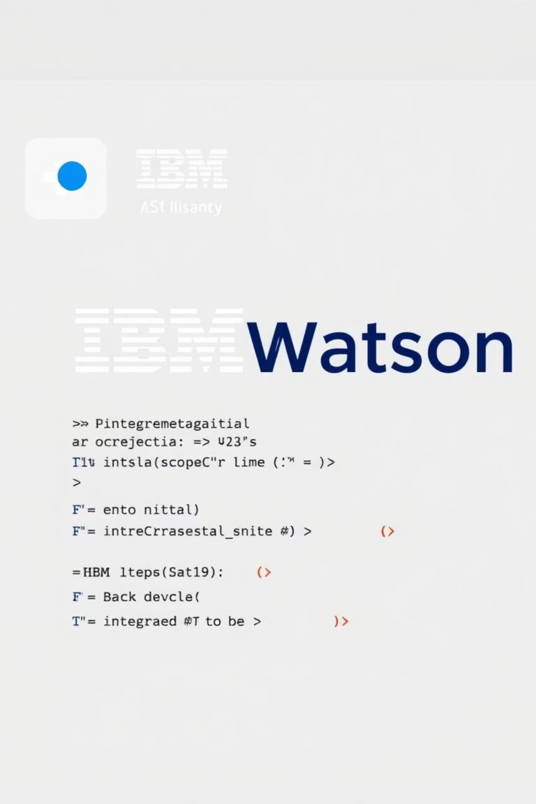
Technology Stack
IBM Watson Assistant
Intents & Entities: Understands user requests.
Slots: Gathers necessary information (mood, genre).
Context Variables: Maintains conversation state.
Dialog Nodes: Manages conversational flow.
Frontend Interface
HTML/CSS: User-friendly web interface.
Embedded Assistant Script: Integrates Watson chatbot seamlessly.

Slide 5

Chatbot Conversation Flow
Process Input
Ask Preferences
Recommend Book
Offer Restart
PagePal processes your input to understand your needs, guides you through mood and genre selection, and then recommends a book. You can easily ask for more or start over.

Slide 6

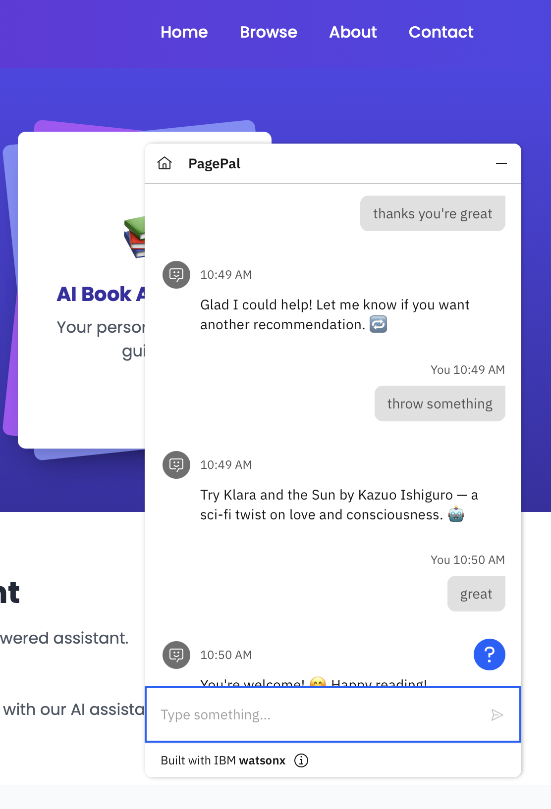
Chatbot in Action

Slide 7

Learnings & Challenges
1
Building Multi-Condition Responses
Crafting dynamic replies based on combined mood and genre inputs.
2
Maintaining Conversational Flow
Ensuring natural transitions and relevant suggestions.
3
Handling Repeated Input & Fallback
Gracefully managing user ambiguity or repetitive queries.

Slide 8




Future Improvements
Voice Based Interaction
Integrate speech-to-text so users can talk to the chatbot instead of typing
User History & Preferences
Save past interactions and tailor future recommendations.
Author-Based Search
Allow users to discover books by their favorite authors.

Slide 9
Conclusion
PagePal: Redefining Book Discovery Through AI
PagePal showcases the power of AI to create personalized and engaging user experiences.
It demonstrates practical application of IBM Watson Assistant in a fun and useful way.

Slide 10

Thank You!

